Slide 1
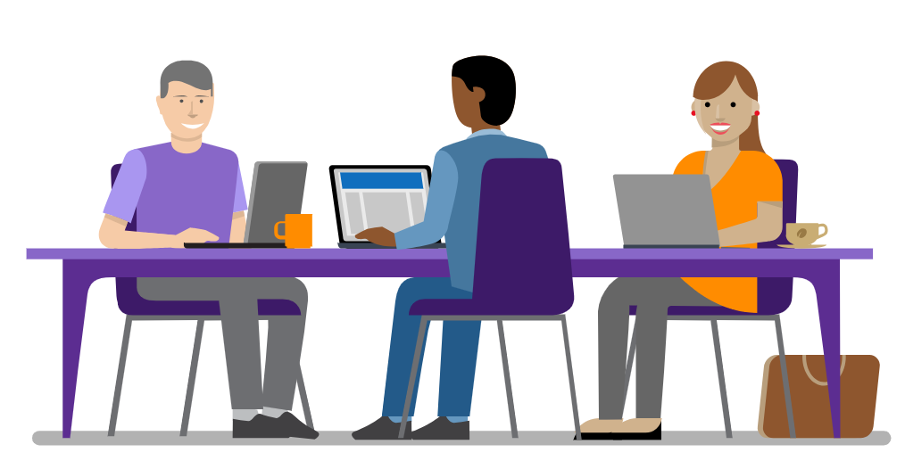
.NET
.NET is a free, cross-platform, open source developer platform for building many different types of applications.

Slide 2
.NET
With .NET, you can use multiple languages, editors, and libraries to build for web, mobile, desktop, gaming, and IoT.

Slide 3
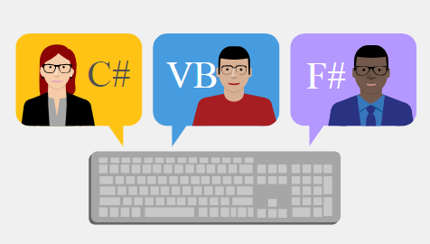
Languages
You can write .NET apps in C#, F#, or Visual Basic.
C# is a simple, modern, object-oriented, and type-safe programming language.
F# is a cross-platform, open-source, functional programming language for .NET. It also includes object-oriented and imperative programming.
Visual Basic is an approachable language with a simple syntax for building type-safe, object-oriented apps.

Slide 4
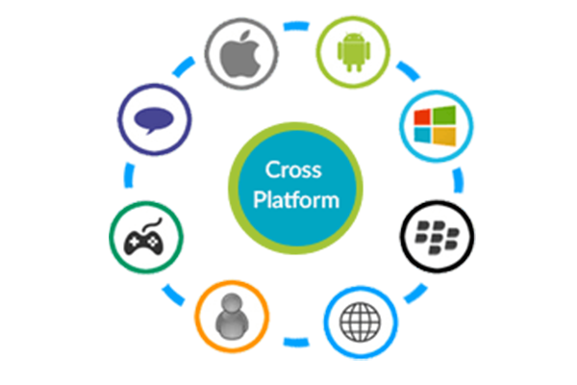
.NET Core is a cross-platform .NET implementation for websites, servers, and console apps on Windows, Linux, and macOS.
.NET Framework supports websites, services, desktop apps, and more on Windows.
Xamarin/Mono is a .NET implementation for running apps on all the major mobile operating systems.
Notes:
Whether you're working in C#, F#, or Visual Basic, your code will run natively on any compatible OS. Different .NET implementations handle the heavy lifting for you:

Slide 5


Application models
You can build many types of apps with .NET. Some are cross-platform, and some target a specific OS or .NET implementation.
Web
Build web apps and services for Windows, Linux, macOS, and Docker.
Mobile
Use a single codebase to build native mobile apps for iOS, Android, and Windows.

Slide 6


Application models
You can build many types of apps with .NET. Some are cross-platform, and some target a specific OS or .NET implementation.
Desktop
Create beautiful and compelling desktop apps for Windows and macOS.
Gaming
Develop 2D and 3D games for the most popular desktops, phones, and consoles.

Slide 7
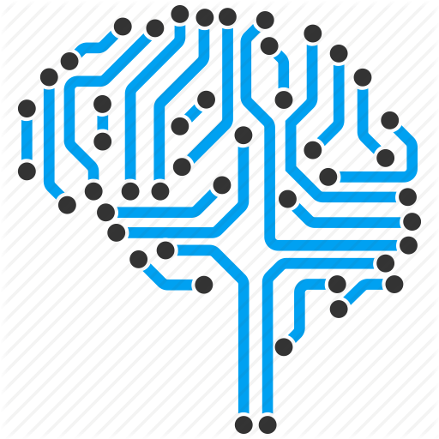
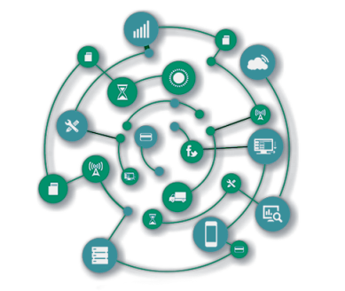
Application models
You can build many types of apps with .NET. Some are cross-platform, and some target a specific OS or .NET implementation.
Machine Learning & AI
Add vision algorithms, speech processing, predictive models, and more to your apps.
Internet of Things
Make IoT apps, with native support for the Raspberry Pi and other single-board computers.

